Slide 1
Cognitive biases in future oriented studies
Andrea Bonaccorsi
University of Pisa
BEFORE Conference
Pisa, 26 November 2019

Slide 2
Phases of foresight (general) | Phases of technology foresight (specific) | Main questions in technology foresight | Type of bias | Impact on technology foresight
Strategic intelli- gence | Statement of the goal of the foresight exercise | Societal issues addressed by the technology | Framing effect | Implicit positive framing of the technology under study Overlooking of risks/ costs of adoption
 | Technology trends | Main trends in the evolution of technology | Desirability bias Overconfidence | Overestimation of the probability of future (beneficial) developments of the technology
Sense making | Technology options | Options available within a given time frame | Advocacy bias Overconfidence | Distorsion in the comparison between future developments of technology
 | Technology roadmap | Time needed to achieve desired levels of performance | Planning fallacy Overconfidence Desirability bias | Underestimation of the time and cost needed to achieve desired levels of performance
Selecting priorities | User analysis | Social and market acceptance of the technology | False consensus effect | Overestimation of the share of potential users interested in the technology Overestimation of technology acceptance
 | Technology maturity analysis | Closeness to the market | Desirability bias Hindsight bias | Overestimation of the maturity of technology Lack of attention to negative information
Implemen- tation | Market analysis | Time path of diffusion of the technology | Anchoring bias Hindsight bias | Anchoring of the market size estimates on the basis of the size of the potential market (saturation level) Tendency to attribute to others the same level of knowledge
 | Policy-making | Decisions based on the foresight results | Overconfidence Advice taking bias | Lack of understanding of the use of results of the foresight study by policy makers

Slide 3
Framing effect
The framing effect describes a situation in which a cognitive task is deeply influenced by its initial description, so that equally legitimate but different task descriptions lead to severely different cognitive outcomes.
people react differently to a decision problem according to the way it is framed in the task description,
In particular, framing a problem in terms of losses induces more risk-taking than framing in terms of gains.
Tversky and Kahneman (1981)
Risk or loss aversion occurs when people prefer a small reward with greater certainty than a large reward with less certainty.
Framing a problem in terms of gains, or improvement, activates a different response (Tversky and Kahneman, 1985).

Slide 4
How do we frame foresight studies?
A commonly adopted framing of foresight questions is in terms of solutions (positive) to unsolved problems (negative).
This is clearly legitimate, but bears the risk of ruling out other representations of technologies and overshadowing their costs and risks

Slide 5
Desirability bias
Experts exhibit a positive correlation between probability assessments of given events and desirability of these events.
This is a distortion originated in the preferences of subjects, which in principle should not interact with cognitive tasks.
The desirability bias is larger when experts
are engaged into affective reactions
there is large uncertainty
the prospect horizon is distant

Slide 6
How do we mitigate the Desirability bias?
People distort their evaluation of probability in the direction of their preferred decision alternative (De Kay, Patino-Echevery and Fischbeck, 2009).
It has been found not only in lay people (Lench and Bench, 2012), but in experts in a variety of fields
professional investors (Olsen, 1997)
price forecasters (Mayraz, 2011)
from political election voters (Redlawsk, 2002)
sport fans (Babad and Katz, 1991).
The Delphi method is able to mitigate overconfidence is not able to address the desirability bias.

Slide 7
Advocacy bias
It refers to the consciuos over-estimation of the prospects for technologies of products, when there is competition for resources (Tull, 1967; Tyebjee, 1987).
Experts may inflate the probability of success in order to actively champion some technologies.
It is important to underline that this bias does not necessarily reflect lack of professionalism or hidden agendas. It may result from genuine beliefs in the superiority of some options, supported by academic research and/or industrial applications, but not adequately subject to counterargumentation.

Slide 8
Overconfidence
This is defined as the misplaced belief in the accuracy of one’s own judgments and is the object of a large literature in cognitive psychology.
Individuals are not able to evaluate correctly the degree of knowledge they have about issues or facts on which their judgment is requested
The dominant effect is that people overestimate their own ability to perform accurate judgments (precision or accuracy), that is, they exhibit overconfidence in the form of overprecision, or unwarranted certainty
They also overestimate their absolute ability or performance (overestimation) and their relative comparison within a group (overplacement)

Slide 9
Planning fallacy
Several studies suggest that people systematically overestimate how much they can achieve in a given time period, or underestimate the time needed to achieve a given result (Kahneman and Tversky, 1979; Sharot, Korn and Dolan, 2011; Sharot, 2012).
People build up scenarios based on a progression of the present to the future and in doing so focus on optimistic scenarios (Newby-Clark et al. 2000).
They persist in this fallacy even in the face of negative feedback (Buehler, Griffin and Ross, 1994). As Camerer and Johnson succintly said: “experts know a lot but predict poorly” (Camerer and Johnson, 1991, 196).

Slide 10
False consensus effect
Recent studies show how user analysis may be affected by large errors, that lead to disastrous outcomes, as in the case of electric cars (Sovacool, Noel and Orsato, 2017).
In particular, user analysis often overestimates the proportion of the population of potential adopters that are willing to adopt a new technology. We suggest that another bias might be at place here, called false consensus effect.
Based on their technical background and positive attitude towards innovations, experts may take for granted the desirability of the technology and severely underestimate the difficulties and obstacles in the adoption. The false consensus effect may suggest a higher-than-true probability of acceptance.

Slide 11
Hindsight bias
The hindsight bias, initially discussed by Fischhoff (1975; 1977), is the unjustified increase in the perceived probability of an event due to the knowledge of how the event actually took place, or outcome knowledge (Hawkins and Hastie, 1990; Agans and Shaffer, 1994).
People who know the outcome of an event find it difficult to report objectively the predictions they made before the knowledge of the outcome.
For example, after the outcome of a disease, physicians may become unable to retrieve the reasons for their diagnosis, which at the time of execution was based on a prediction judgment (Arkes and Harkness, 1980; Arkes et al. 1981; Arkes and Freedman, 1984; Zwaen et al. 2016).

Slide 12
Anchoring effect
In producing numeric estimates of unknown quantities, people are heavily influenced by the information provided in the task description, even when it is not consistent or realistic (Gigerenzer, 2002).
In other words, according to Kahneman and Tversky (1974), people anchor their estimate to the number provided in the description and incorporate new information by adjusting the estimate above and below the anchor.
In this way people do not make efficient use of information available and may be distorted in their judgment (Thorsteinson et al. 2008).

Slide 13
Advice taking bias
It is often reported that the authors of technology foresight complain about the low level of utilization of their results.
Policy makers do not actively refer to the results of studies in their public declarations or in decision-making.
Here we find evidence of a bias, extensively examined in social psychology, which is not produced by the experts that deliver technology foresight studies, but by their institutional sponsors.
In a nutshell, people in power positions tend to be overconfident (Galasso and Simcoe, 2011; Goldfarb et al. 2012; Hribar and Yang, 2015) and to take little advice from others (advice taking bias: Bonaccio and Dalal, 2006; See et al. 2011).

Slide 14
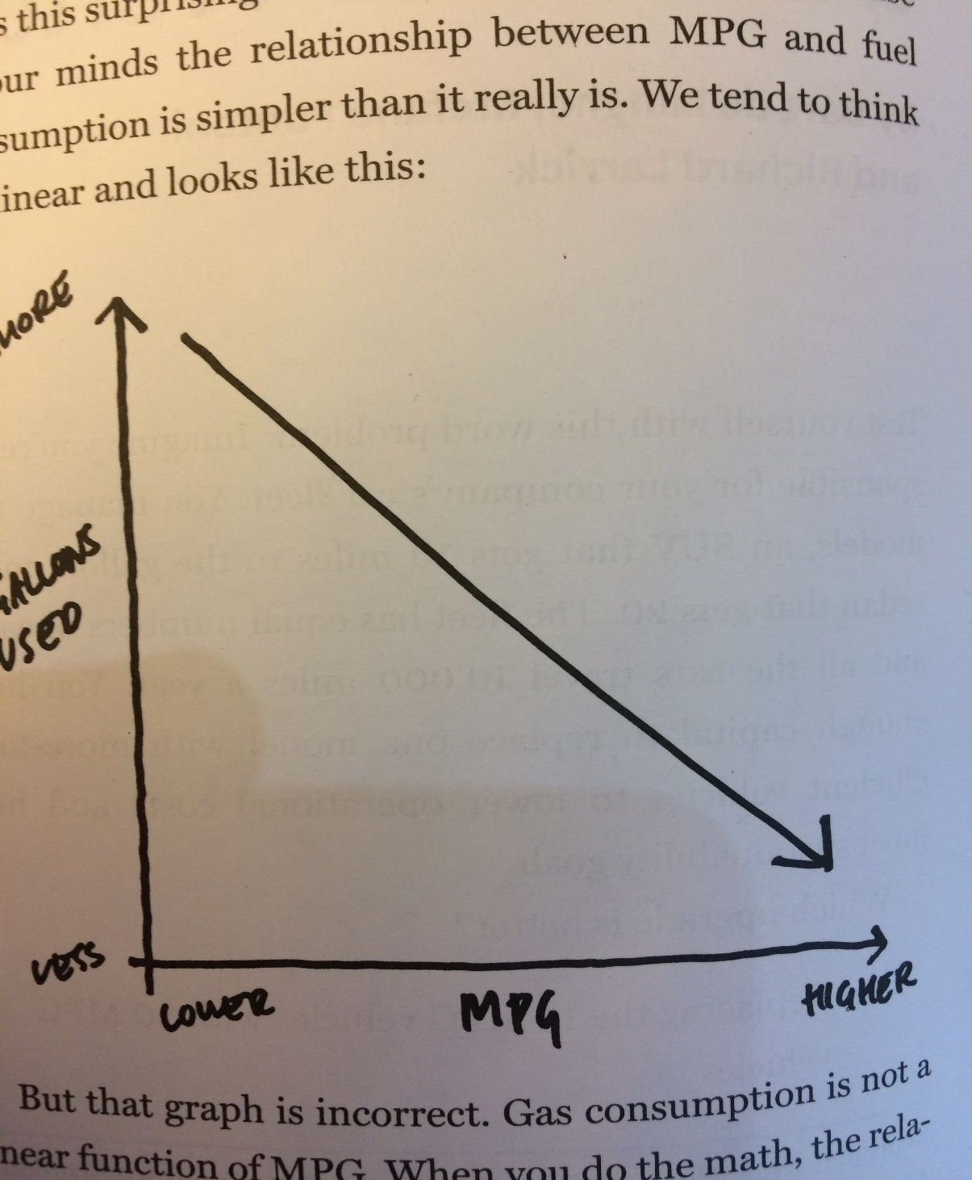
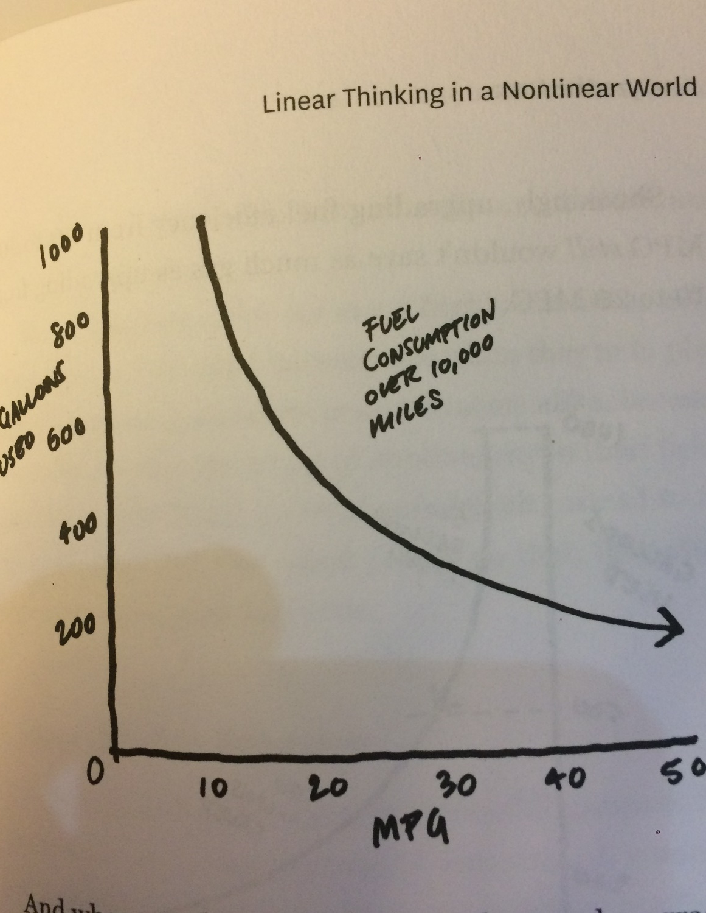

Slide 15
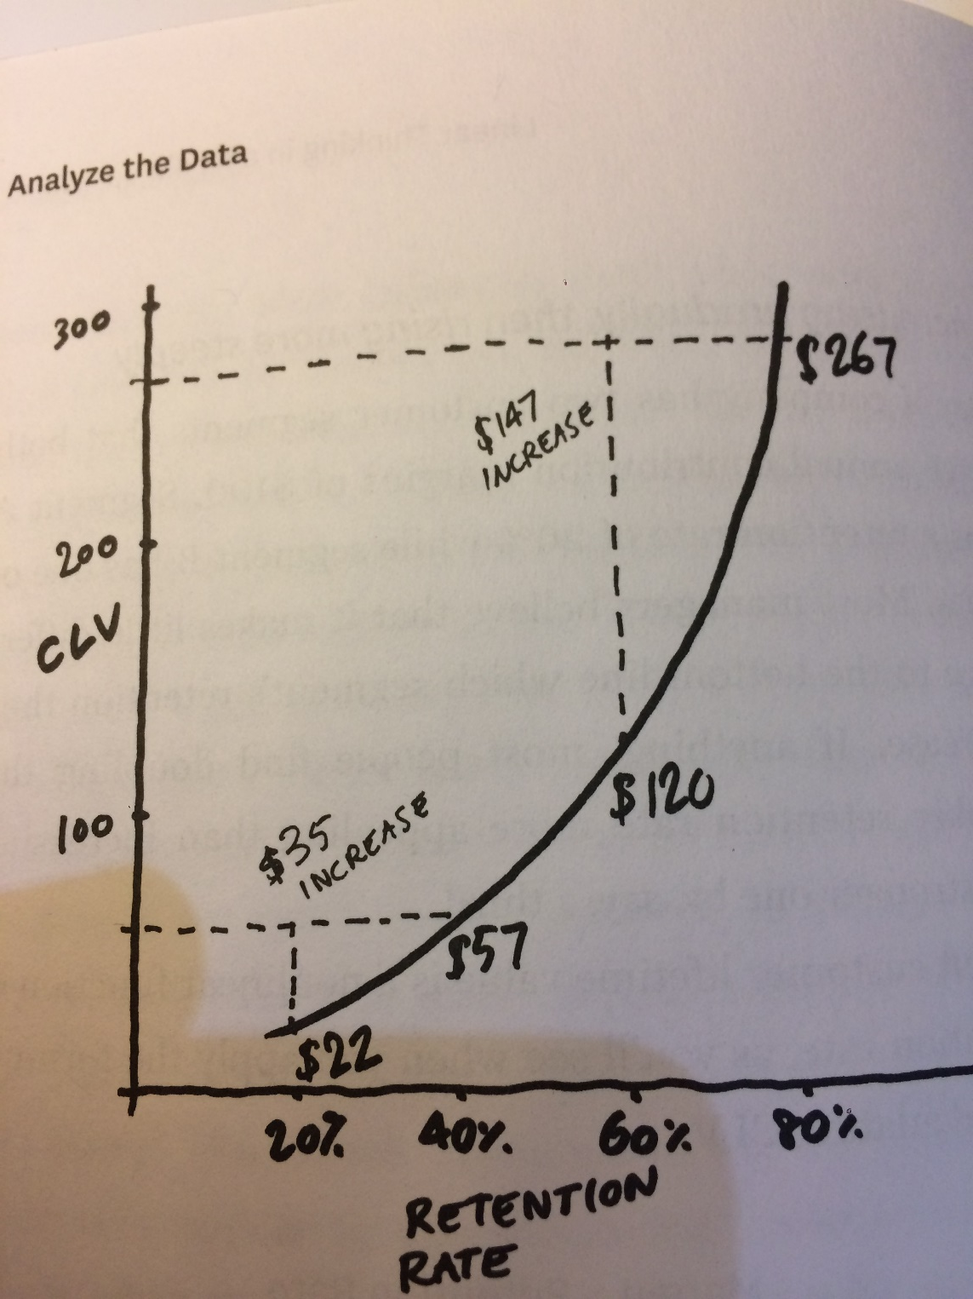
Case n. 1
Customer Lifetime Value grows exponentially in respect to retention rate growth.

Slide 16
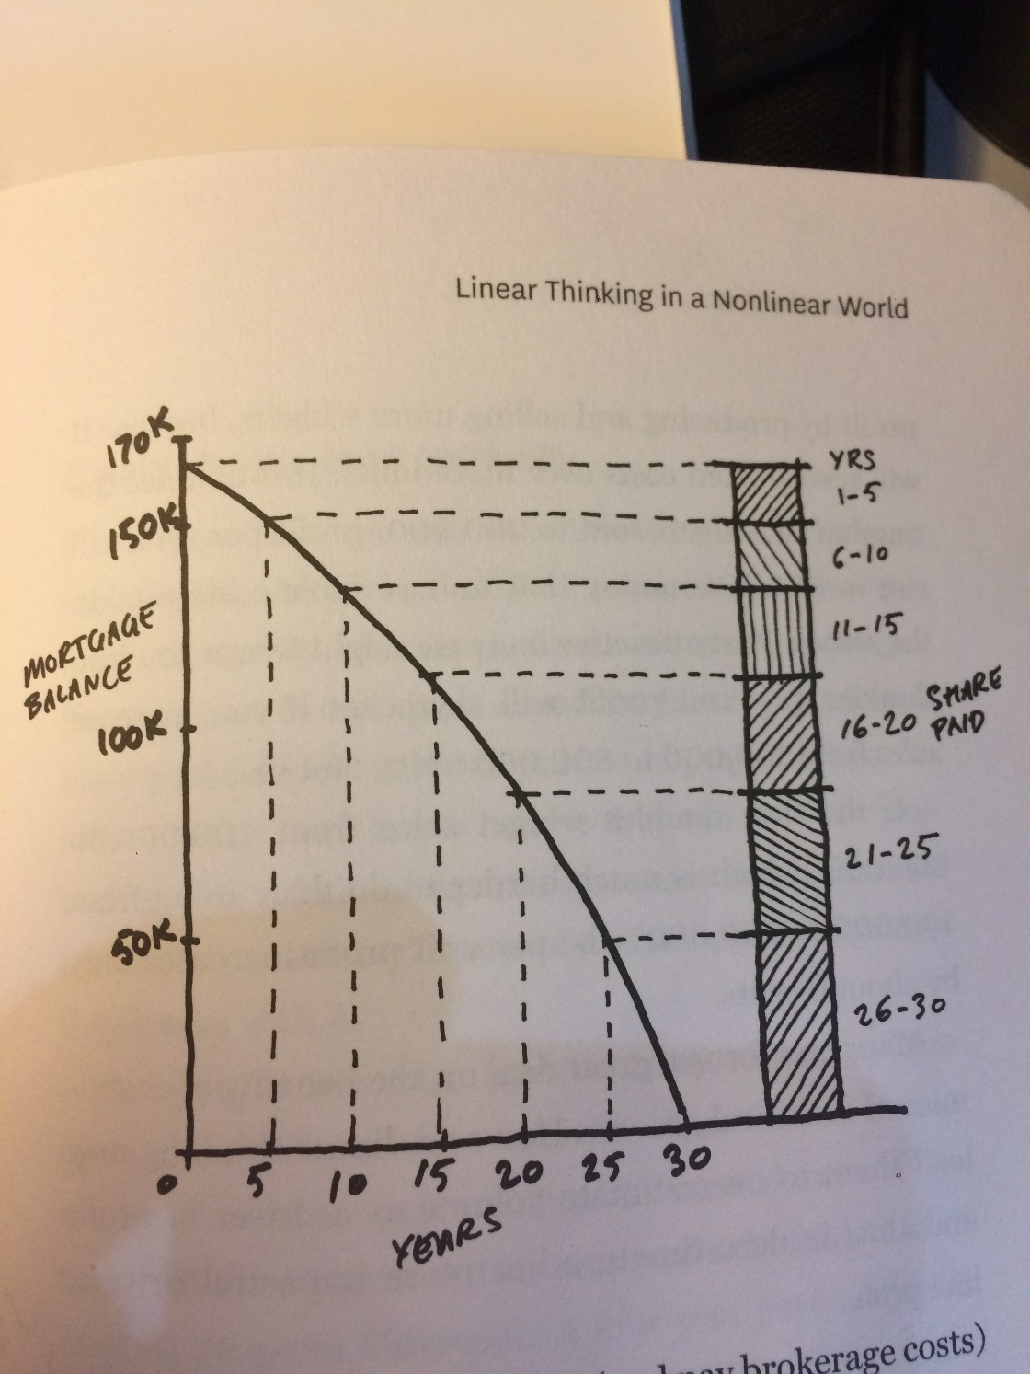
Case n. 2
Mortgage balance decrease exponentially in respect of the remaining years to expire the bank loan.

Slide 17
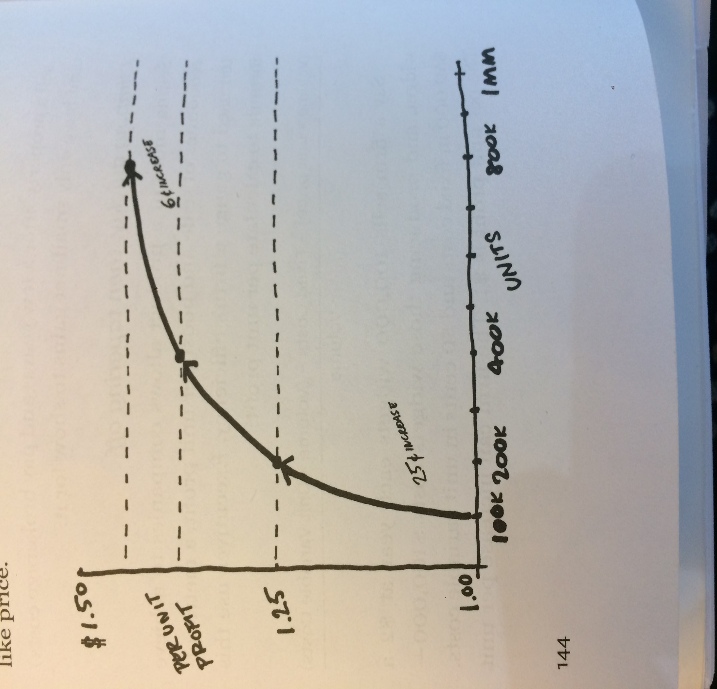
Case n. 3
It grows fast at the beginning then the growth rate decrease.
It is the case of the expansion of production targets to reduce fixed costs.

Slide 18
Non-linear relationships
Green consumption preferences
High average score about purchase intentions
Real purchases only from customers with the highest score
Customer satisfaction and brand loyalty
High-satisfaction customers change consumption habits
In high-competitive industries, brand loyalty can be reached only with very high customer satisfaction rates
Social media interaction and purchase behaviour
YouTube videos posted by ONG have a huge amount of interactions but very few contributions
Google search position and sales volume
Non linear relationship between sales volume and Google position of a company/brand

Slide 19
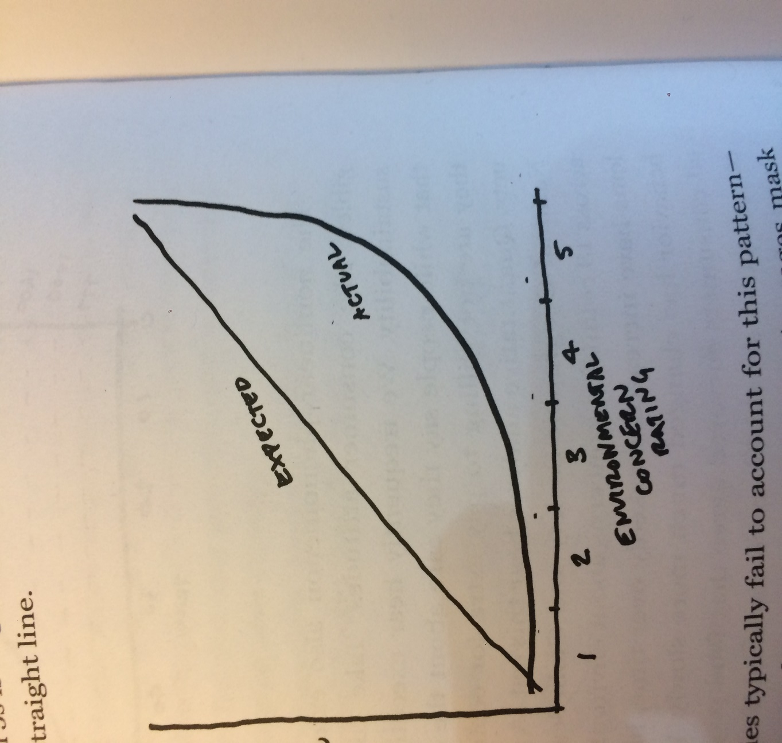
Green consumption preferences
Customers state high concerns about environmental challenges and climate changes. However, sustainable product sales doesn’t grow in a linear way if compared with the level of environmental concern.

